Slide 1
AAT(TECH TALK)
THEORY OF COMPUTATION
20955-A-1206
MOHAMMED ADNAAN UDDIN
INFROMATION TECHNOLOGY (SECTION-A)

Slide 2
TOPIC
Turing Reducibility

Slide 3
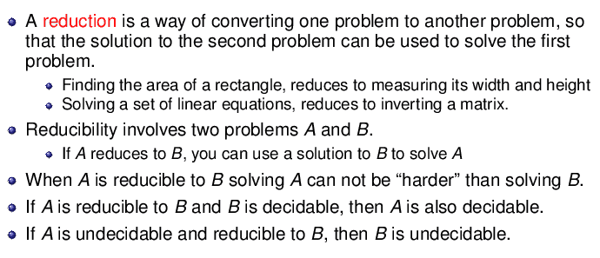
REDUCIBILITY

Slide 4

TURNING REDUCIBILITY
Given two sets A,B N of natural numbers, we say A is Turing reducible to B and write
if there is an oracle machine that computes the characteristic function of A when run with oracle B. In this case, we also say A is B-recursive and B-computable.

Slide 5

TURNING REDUCIBILITY
If there is an oracle machine that, when run with oracle B, computes a partial function with domain A, then A is said to be B-recursively enumerable and B-computably enumerable.
We say A is Turing equivalent to B and write if both

Slide 6
TURNING REDUCIBILITY
The equivalence classes of Turing equivalent sets are called Turing degrees
The Turing degree of a set X is written as deg(X).

Slide 7
Relation of Turing completeness to computational universality
Turing completeness, as just defined above, corresponds only partially to Turing completeness in the sense of computational universality.
Specifically, a Turing machine is a universal Turing machine if its halting problem (i.e., the set of inputs for which it eventually halts) is many-one complete.

Slide 8
Relation of Turing completeness to computational universality
A necessary but insufficient condition for a machine to be computationally universal, is that the machine's halting problem be Turing-complete for the set X of recursively enumerable sets.

Slide 9
Properties
Every set is Turing equivalent to its complement
Every computable set is Turing reducible to every other set. Because any computable set can be computed with no oracle, it can be computed by an oracle machine that ignores the given oracle.
The relation is transitive: if A is B and B C then A C

Slide 10
Properties
There are pairs of sets (A,B) such that A is not Turing reducible to B and B is not Turing reducible to A. Thus is not a Total order
There are infinite decreasing sequences of sets under Thus this relation is not well-founded.
Every set is Turing reducible to its own Turing jump, but the Turing jump of a set is never Turing reducible to the original set.

Slide 11
Thank you

